Slide 1
Hardware & Software
Career Preparedness
Business Technology Applications

Slide 2
Computer
http://www.youtube.com/v/7cXEOWAStq4?autoplay=1&iv_load_policy=3&fs=1
What is a computer?
A computer is an electronic device that when given instructions accepts data, processes data, and produces output that is useful information.
  Data is raw facts given to a computer during input.
  Information is data that has been processed.

Slide 3
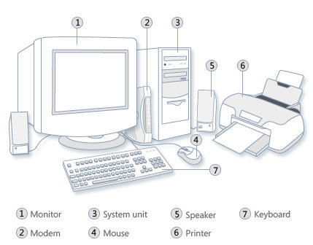
Components of the Personal Computer
Input – data used by the computer

Slide 4
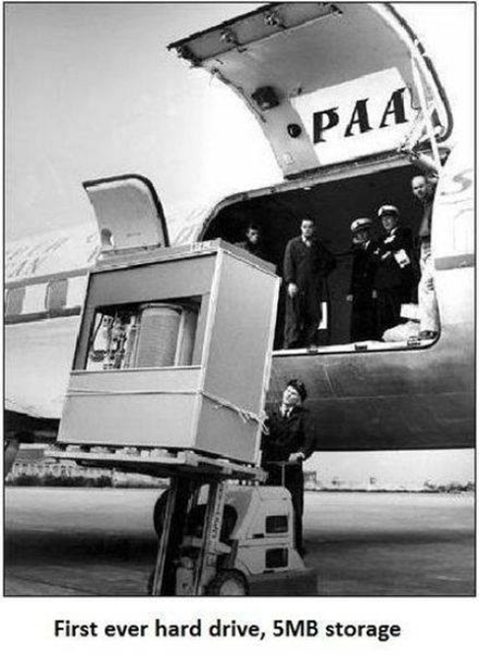

Slide 5
Information Processing Cycle
Input
Memory/
Storage
Processor
Output
Notes:
This is what a computer does.

Slide 6
Information Processing Cycle
Input
Memory/
Storage
Processor
Instructions
Output
Notes:
This is what a computer does.

Slide 7
Information Processing Cycle
Input
Accepts data
Memory/
Storage
Processor
Instructions
Output
Notes:
This is what a computer does.

Slide 8
Information Processing Cycle
Input
Accepts data
Memory/
Storage
Processes data
Processor
Instructions
Output
Notes:
This is what a computer does.

Slide 9
Information Processing Cycle
Input
Accepts data
Memory/
Storage
Processes data
Processor
Instructions
Output
Useful information
Notes:
This is what a computer does.

Slide 10
Memory
Input
RAM – Random Access Memory
-where we work
-data is lost w/out power
Memory/
Storage
Processor
ROM – Read Only Memory
-permanent memory
-holds software
Output
Notes:
This is what a computer does.

Slide 11
Cache Memory
Cash
extremely fast
stores repeatedly required instructions
improving overall system speed
Notes:
extremely fast memory that is built into a computer’s central processing unit (CPU), or located next to it on a separate chip. The CPU uses cache memory to store instructions that are repeatedly required to run programs, improving overall system speed. The advantage of cache memory is that the CPU does not have to use the motherboard’s system bus for data transfer. Whenever data must be passed through the system bus, the data transfer speed slows to the motherboard’s capability. The CPU can process data much faster by avoiding the bottleneck created by the system bus.

Slide 12

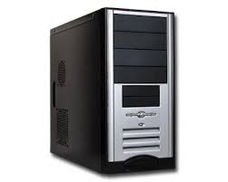
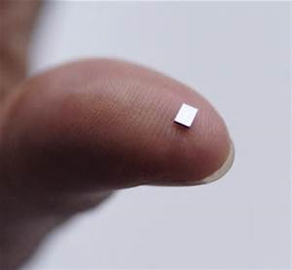
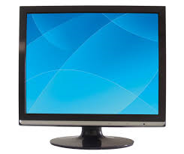
Information Processing Cycle
The computer uses a combination of hardware and software to carry out the information processing cycle.

Slide 13
Different Types of Computers

Slide 14
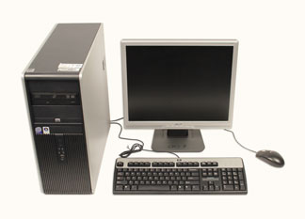
Desktop
Work, home, school, library
Easy to upgrade and exand
Cost: Less expensive than laptop
Keyboard for typing
Mouse for navigation

Slide 15
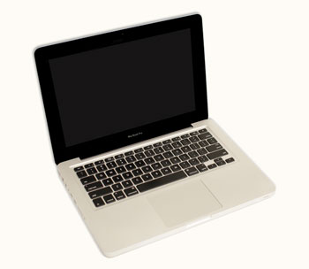
Laptop
Battery or AC powered
More portable than desktop
Not as easily upgradaded
Touchpad for navigation instead of mouse

Slide 16
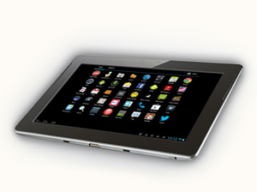
Tablet
Handheld
More portable than laptop
Touch-sensitive screen instead of keyboard/mouse for typing and navigation

Slide 17
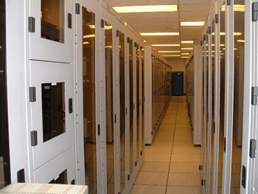
Servers
Computer that serves up information to other computers on a network.
Can look like a desktop or be much larger
Where Internet webpages are stored

Slide 18
Specialized Computers
Mobile phones/smart phones
Game console
TVs

Slide 19
Hardware vs. Software
Hardware
Software
Any part of the computer that has physical structure
Ex: keyboard/mouse, internal parts
A set of instructions that tells the hardware what to do.
Guides the hardware and tells it how to accomplish tasks.
Ex: web browsers, games, word processors
Everything you do on your computer will require both hardware and software.

Slide 20
HARDWARE

Slide 21
Notes:
7. Input – data used by the computer
8. Output – information produced by a computer program/software
18. Peripheral – a device attached to a CPU.

Slide 22
Input | Output | Processor | Peripheral
Keyboard Mouse Microphone Scanner | Monitor Speakers Printer | Motherboard CPU (microchip) | Speakers Microphone Etc.

Slide 23
SOFTWARE

Slide 24
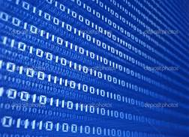
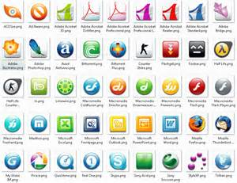
Software
Term that describes computer programs.
Instructions for the computer.

Slide 25
Types of Software
Application Software
Utility Software
Operating System Software
Notes:
Operating System software performs basic tasks, such as
recognizing input from the keyboard,
sending output to the display screen,
keeping track of files and directories on the disk, and
controlling peripheral devices such as printers.
Utility - A program that performs a very specific task, usually related to managing system resources.
Application software is a program or group of programs designed for end users.

Slide 26
Types of Software
Application Software
Utility Software
Operating System Software
Fundamental
-Needed to boot up
-every computer> desktop, laptop, tablet, cell phone has an OS
-provides a GUI – graphical user interface
Ex: Windows, Mac OS X
Notes:
Operating System software performs basic tasks, such as
recognizing input from the keyboard,
sending output to the display screen,
keeping track of files and directories on the disk, and
controlling peripheral devices such as printers.
Utility - A program that performs a very specific task, usually related to managing system resources.
Application software is a program or group of programs designed for end users.

Slide 27
Types of Software
-Maintains, manages, and protects system
-keeps computer running smoothly
Examples:
-backup/update
-Security (virus/spyware)
Spam/Pop-up Blocker
Screensaver, Themes, Wallpaper
Adobe Flash Player
Application Software
Utility Software
Operating System Software
Fundamental
-Needed to boot up
-every computer> desktop, laptop, tablet, cell phone has an OS
-provides a GUI – graphical user interface
Ex: Windows, Mac OS X
Notes:
Operating System software performs basic tasks, such as
recognizing input from the keyboard,
sending output to the display screen,
keeping track of files and directories on the disk, and
controlling peripheral devices such as printers.
Utility - A program that performs a very specific task, usually related to managing system resources.
Application software is a program or group of programs designed for end users.

Slide 28
Types of Software
-End user software
-each is specific
Examples:
-Word
-Excel
-PowerPoint
-Maintains, manages, and protects system
-keeps computer running smoothly
Examples:
-backup/update
-Security (virus/spyware)
Spam/Pop-up Blocker
Screensaver, Themes, Wallpaper
Adobe Flash Player
Application Software
Utility Software
Operating System Software
Fundamental
-Needed to boot up
-every computer> desktop, laptop, tablet, cell phone has an OS
-provides a GUI – graphical user interface
Ex: Windows, Mac OS X
Notes:
Operating System software performs basic tasks, such as
recognizing input from the keyboard,
sending output to the display screen,
keeping track of files and directories on the disk, and
controlling peripheral devices such as printers.
Utility - A program that performs a very specific task, usually related to managing system resources.
Application software is a program or group of programs designed for end users.

Slide 29
More About the Operating System
http://www.gcflearnfree.org/computerbasics/2

Slide 30
Software Suite
Microsoft Office
Word
Excel
PowerPoint
OneNote
Outlook
Publisher
Access

Slide 31
Software Suite
Microsoft Office
Word
Excel
PowerPoint
OneNote
Outlook
Publisher
Access
Word processor

Slide 32
Software Suite
Microsoft Office
Word
Excel
PowerPoint
OneNote
Outlook
Publisher
Access
Spreadsheet application
Create charts and graphs

Slide 33
Software Suite
Microsoft Office
Word
Excel
PowerPoint
OneNote
Outlook
Publisher
Access
Presentation application

Slide 34
Software Suite
Microsoft Office
Word
Excel
PowerPoint
OneNote
Outlook
Publisher
Access
Email, calendar, tasks

Slide 35
Software Suite
Microsoft Office
Word
Excel
PowerPoint
OneNote
Outlook
Publisher
Access
Digital notebook: single place to gather notes and information

Slide 36
Software Suite
Microsoft Office
Word
Excel
PowerPoint
OneNote
Outlook
Publisher
Access
Flyers,
brochures,
Etc.

Slide 37
Software Suite
Microsoft Office
Word
Excel
PowerPoint
OneNote
Outlook
Publisher
Access
Database,
Reports, tables

Slide 38
Storage Size & Processor Speeds
Bits, Bytes, & hertz

Slide 39
Storage & Memory
Bit | Binary digit 0 or 1 | Smallest unit of data used by a computer
Byte | 8 bits | 1 Byte is equal to one character.
Kilobyte | 1,000 Bytes | 1 KB = 1 paragraph
Megabyte | 1,000 Kilobytes | 100 MB = 2 volumes of encyclopedia
Gigabyte | 1,000 Megabytes | Common term when referring to disk space or drive storage
Terabyte | 1,000 GB One trillion Bytes | 300 hours of video

Slide 40
Clock Speed
The speed of a computer’s CPU
  a measure of how quickly a computer completes basic computations and operations.
Cycles per second
  Measured in hertz (Hz)
  One cycle per second is one hertz.
Measured in megahertz (MHz) and gigahertz (GHz)

Slide 41
NETWORKS

Slide 42
Network Basics
Consist of servers and clients
Protocol – the language that computers use to talk to each other.
  http – hypertext transfer protocol
  Used in web browsers and web servers

Slide 43
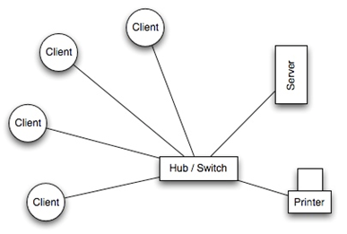
Local Area Network (LAN)
Geographically small
Tied to one building or site
Use cables or low-power radio to connect

Slide 44
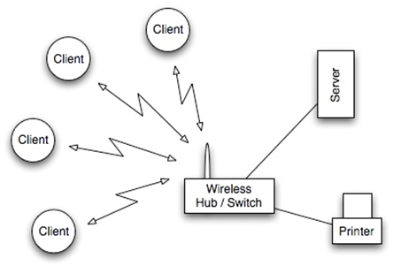
Wireless Local Area Network (WLAN)
LAN that uses radio signals (WiFi) to connect computers
Wireless switch or router at the center
  Small box with one or two antennas
  Sends and receives data
Difficult to secure
Legal Aspects

Slide 45
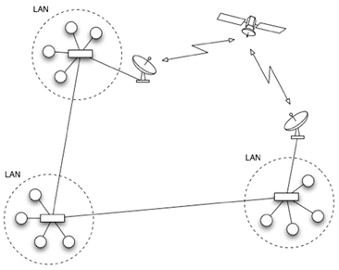
Wide Area Network (WAN)
Extends over a large area
Often joins several LANs together
Links between computers are over long distances
Connect through optical fiber cables, satellite radio links, microwave radio links
The Internet is a global WAN

Slide 46
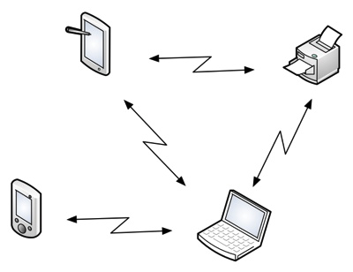
Bluetooth (Personal Area Network)
Wireless technology for short-range connections
Eliminates need for USB cables that connect computer to peripherals
Contain low-power radio transmitters and receivers
Examples:
  Wireless keyboard or mouse
  Wireless headset with cell phone

Slide 47
IP and ISP
Who provides the connection?
Internet Service Providers provide the hardware like cables and fiber optics.
  Examples?
How are individual clients/computers identified in a network?
IP Address
  Internet Protocol address
  What’s yours?

Slide 48
The Internet

Slide 49
The Internet
Early days: used to search for information
Today: constantly evolving tool that provides new ways of accessing, interacting, and connecting with people and content

Slide 50
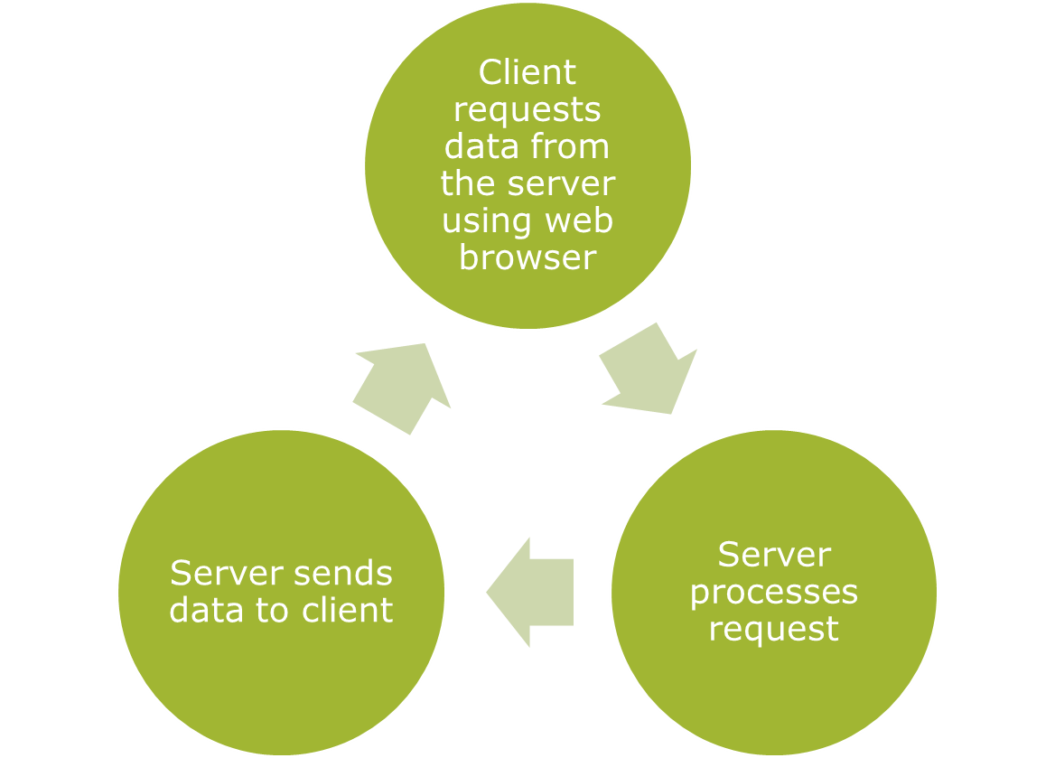
What is it exactly?
The largest computer network in the world.

Slide 51
Client requests data from the server using web browser
Server processes request
Server sends data to client
Client requests data from the server using web browser
Server processes request
Server sends data to client

Slide 52
World Wide Web
Internet and World Wide Web are used interchangeably, but are not the same thing!
Internet is the physical network of computers all over the world.
World Wide Web is a virtual network of websites connected by hyperlinks (links)
Websites are stored on servers on the Internet, so the world wide web is a part of the Internet

Slide 53
HTML
The backbone of the World Wide Web: HTML files
Specially formatted documents that can contain links, images, or other media.
All web browsers can read HTML Files

Slide 54
URL
Uniform Resource Locator (URL): The web address
For example:
www.sehsfbla.weebly.com
www.mysehs.com
www.sehsbusinessmgt.weebly.com

Slide 55
Did You Know?
The World Wide Web was created in 1989 by Tim Berners-Lee, a software engineer.
Before then, computers could communicate over the Internet, but there were no web pages.
The Internet began in 1969 when the US Dept of Defense created ARPAnet, a project to allow military personnel to communicate in an emergency.

Slide 56
By 2012, there were 2.4 billion internet users (1/3 the earth’s population)
To store all the information available on the Internet, you would need 1 Billion DVDs or 200 Million Blu-ray discs!

Slide 57
Finding Information Online
Search engine
  Finding information online
  Google
Intelligent personal assistants
  Siri

Slide 58
Using the Internet to Communicate
Social networking/social media
  Facebook
  Twitter
  Instagram
  linkedIn
Chat and Instant messaging
  Yahoo! Messenger
  Facebook

Slide 59
VoIP – Voice over Internet Protocol
  Telephone service through Internet connection
  Skype
  FaceTime
Blogs
  Shape the Internet by adding to it
  Share your thoughts
  Blogger.com
  Wordpress.com

Slide 60

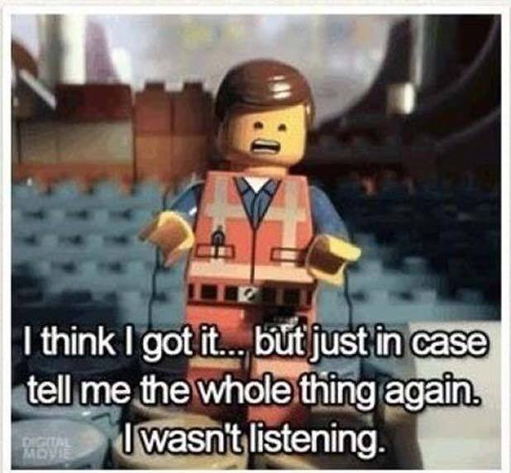

Slide 61
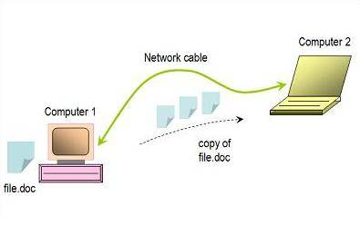
Simple Network
two computers make a direct connection with each other and communicate across a wire or cable.
have existed for decades.
common use is file sharing.

Slide 62
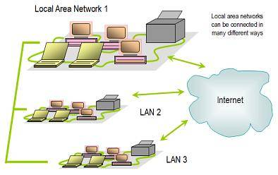
Local Area Network
group of computers located in a home, school, or part of an office building.
share files and printers.
can share connections with other LANs and with the Internet

Slide 63
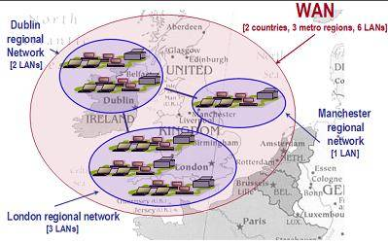
Wide Area Network
Wide area networks cover a large geographic area like a city, a country or multiple countries.
normally connect multiple LANs and other smaller-scale area networks.
built by large telecommunication companies and other corporations using highly-specialized equipment not found in consumer stores
The Internet is an example of a WAN that joins local and metropolitan area networks across most of the world.
Notes:
This diagram illustrates a hypothetical wide area network (WAN) configuration that joins LANs in three metropolitan locations.

Slide 64
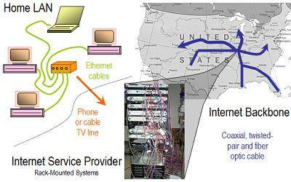
Wired Computer Networks
twisted-pair Ethernet cables are often used to connect computers.
Phone or cable TV lines in turn connect the LAN to the Internet Service Provider (ISP).
ISPs use a mix of different kinds of cable to join this equipment to LANs and the Internet.
Much of the Internet uses high-speed fiber optic cable to send traffic long distances underground, but twisted pair and coaxial cable can also be used for leased lines and in more remote areas.

